Slide 1
SQL Part 2 of 5

Slide 2
The Rename Operation
The SQL allows renaming relations and attributes using the as clause:
old-name as new-name
Find the name, loan number and loan amount of all customers; rename the column name loan_number as loan_id.
select customer_name, borrower.loan_number as loan_id, amount
from borrower, loan
where borrower.loan_number = loan.loan_number
Notes:
9

Slide 3
Tuple Variables
Tuple variables are defined in the from clause via the use of the as clause.
Example:1
Find the customer names and their loan numbers for all customers having a loan at some branch.
Notes:
10

Slide 4
Find the customer names and their loan numbers for all customers having a loan at some branch.
select customer_name, T.loan_number, S.amount
from borrower as T, loan as S
where T.loan_number = S.loan_number
Keyword as is optional and may be omitted
borrower as T ≡ borrower T
Notes:
10

Slide 5
Example:2
Find the names of all branches that have greater assets than some branch located in Brooklyn.
Notes:
10

Slide 6
Find the names of all branches that have greater assets than
some branch located in Brooklyn.
select distinct T.branch_name
from branch as T, branch as S
where T.assets > S.assets and S.branch_city =
'Brooklyn'
Keyword as is optional and may be omitted
branch as T ≡ branch T
Notes:
10

Slide 7
String Operations
SQL includes a string-matching operator for comparisons on character strings. The operator “like” uses patterns that are described using two special characters:
  percent (%). The % character matches any substring.
  underscore (_). The _ character matches any character.
Find the names of all customers whose street includes the substring “Main”.
select customer_name
from customer
where customer_street like '%Main%'
Match the name “Main%”
like 'Main\%' escape '\'
SQL supports a variety of string operations such as
  concatenation (using “||”)
  converting from upper to lower case (and vice versa)
  finding string length, extracting substrings, etc. (Try in lab)

Slide 8
Ordering the Display of Tuples
List in alphabetic order the names of all customers having a loan in Perryridge branch
select distinct customer_name
from borrower, loan
where borrower.loan_number = loan.loan_number and
branch_name = 'Perryridge'
order by customer_name

Slide 9
Ordering the Display of Tuples
We may specify desc for descending order or asc for ascending order, for each attribute; ascending order is the default.
  Example:
    Select*
    From loan
    order by amount desc, loan_number asc

Slide 10
Figure 3.1: Database Schema
branch (branch_name, branch_city, assets)
customer (customer_name, customer_street, customer_city)
loan (loan_number, branch_name, amount)
borrower (customer_name, loan_number)
account (account_number, branch_name, balance)
depositor (customer_name, account_number)

Slide 11
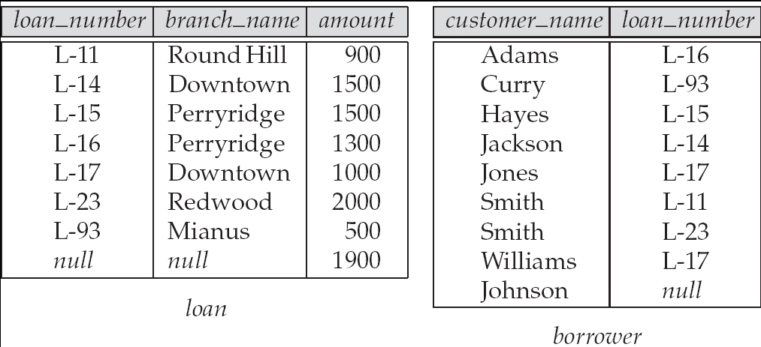
Figure 3.3: Tuples inserted into loan and borrower

Slide 12

Figure 3.4:
The loan and borrower relations

